Slide 1
Chapter 14
Functional Dependencies and Normalization
Informal Design Guidelines for Relational Databases
  Semantics of the Relation Attributes
  Redundant Information in Tuples and Update Anomalies
  Null Values in Tuples
  Spurious Tuples
Functional Dependencies (FDs)
  Definition of FD
  Inference Rules for FDs

Slide 2
(cont.)
  Equivalence of Sets of FDs
  Minimal Sets of FDs
Normal Forms Based on Primary Keys
  Introduction to Normalization
  First Normal Form
  Second Normal Form
  Third Normal Form
General Normal Form Definitions(For Multiple Keys)
BCNF(Boyce-Codd Normal Form)

Slide 3
1. Informal Design Guidelines for Relational Databases
What is relational database design?
  The grouping of attributes to form “good” relation schemas
Two levels of relation schemas:
  The logical “user view” level
  The storage “base relation” level
Design is concerned mainly with base relations
What are the criteria for “good” base relations?
We first discuss informally guidelines for good relational design

Slide 4
(cont.)
Then we discuss formal concepts of functional dependencies and normal forms
  1NF (First Normal Form)
  2NF (Second Normal Form)
  3NF (Third Normal Form)
  BCNF (Boyce-Codd Normal Form)
Additional types of dependencies, further normal forms, relational design algorithms are discussed in Chapter 15

Slide 5
1.1 Semantics of the Relation Attributes
Informally, each tuple should represent one entity or relationship instance
Attributes of different entities (EMPLOYEEs, DEPARTMENTs, PROJECTs) should not be mixed in the same relation
Only foreign keys should be used to refer to other entities

Slide 6
1.2 Redundant Information in Tuples and Update Anomalies
Mixing attributes of multiple entities may cause problems
Information is stored redundantly wasting storage
Problems with update anomalies:
  Insertion anomalies
  Deletion anomalies
  Modification anomalies

Slide 7
1.3 Null Values in Tuples
Relation should be designed such that their tuples will have few NULL values if possible
Attributes that are NULL frequently could be placed in separate relations(with the primary key)

Slide 8
1.4 Spurious Tuples
Bad designs for a relational database may result in erroneous results for certain JOIN operations
The “lossless join” property is used to guarantee meaningful results for join operations
The relations should be designed to satisfy the lossless join condition Discussed in Chapter 15

Slide 9

Figure 14.2

Slide 10
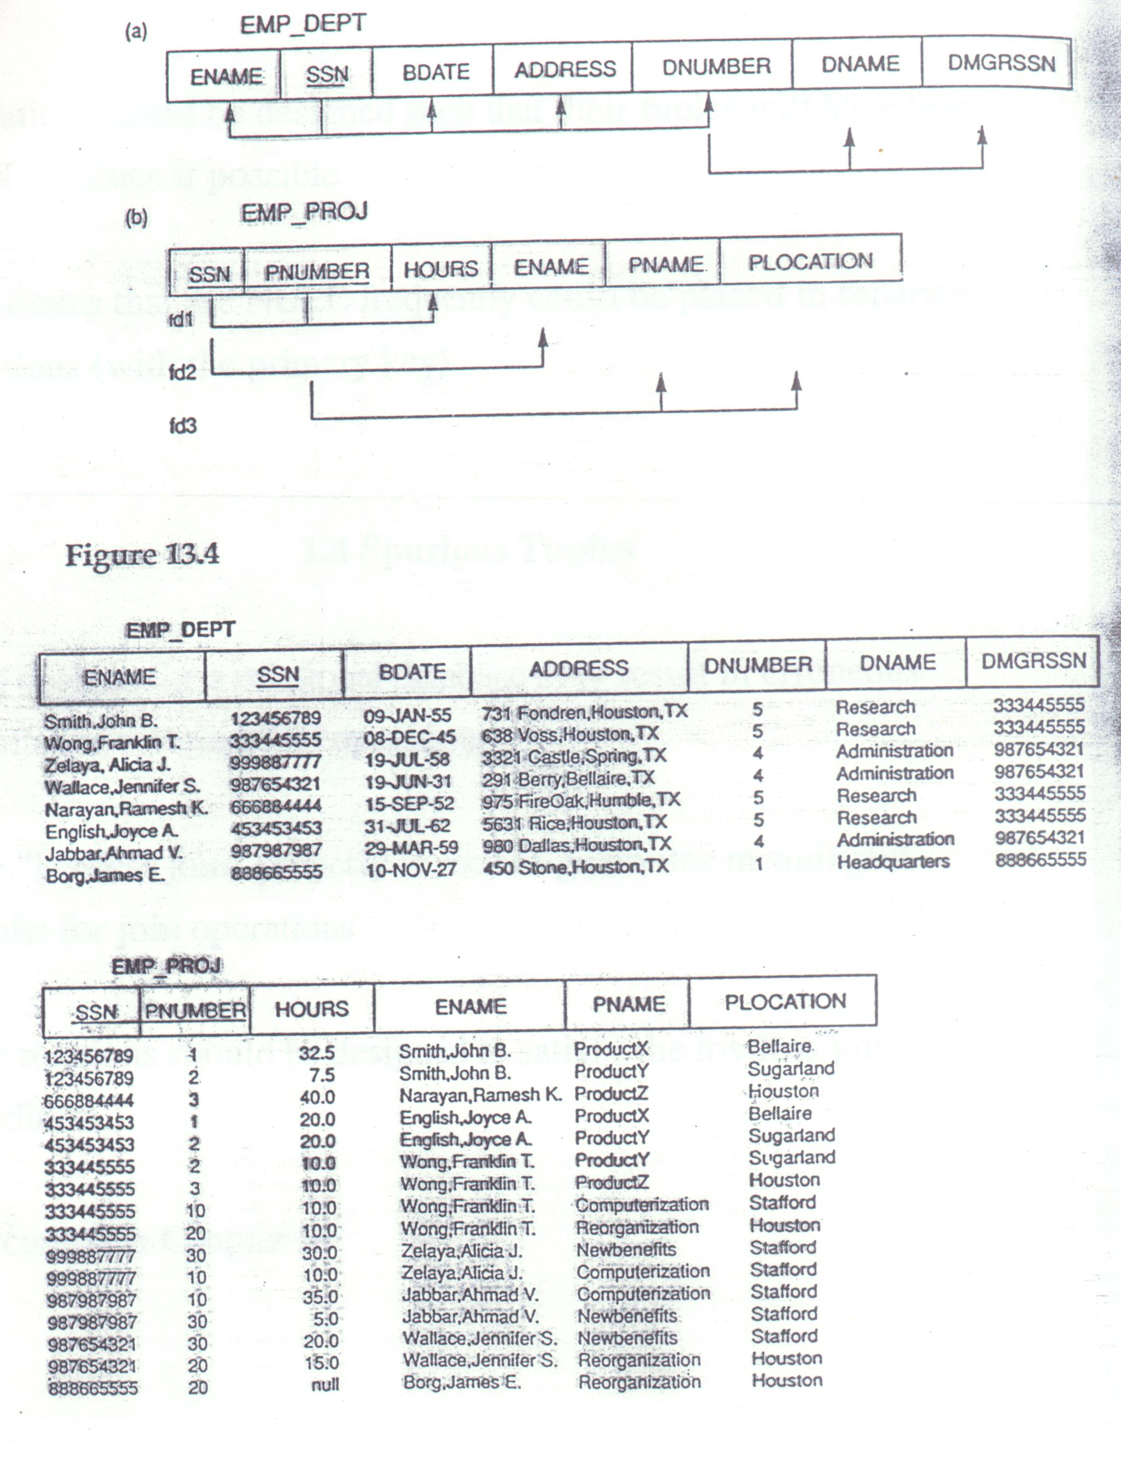
Figure 14.3

Slide 11
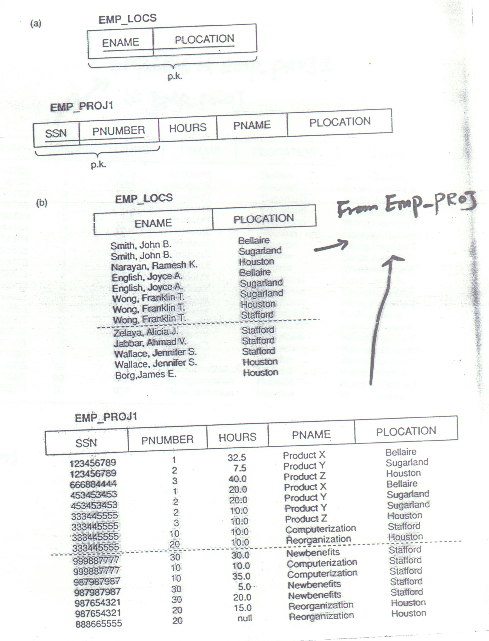
Figure 14.5

Slide 12
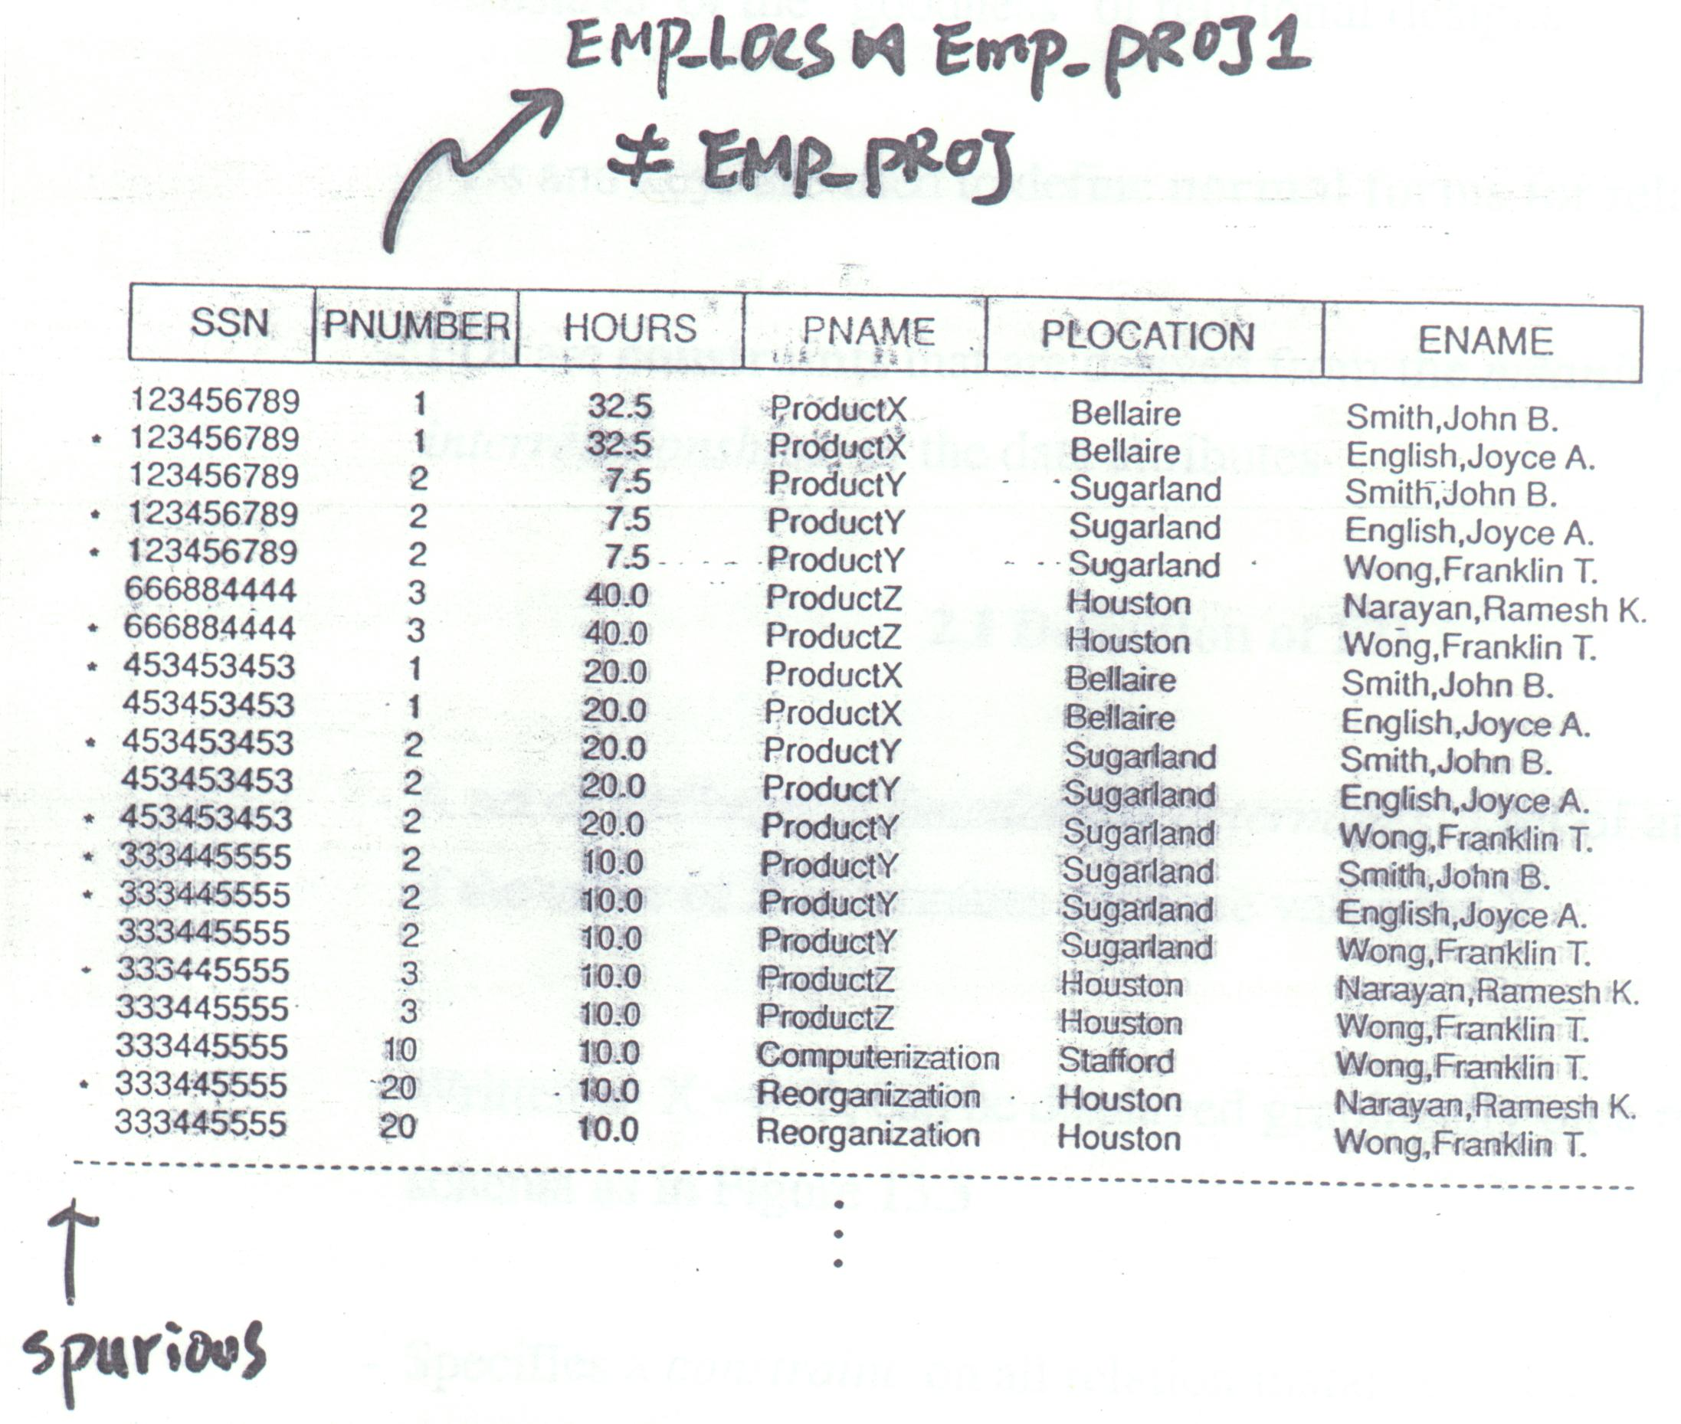
Figure 14.6

Slide 13
2.Functional Dependencies
Functional dependencies(FDs) are used to specify formal measures of the “goodness” of relational designs
FDs and keys are used to define normal forms for relations
FDs are constraints that are derived from the meaning and interrelationships of the data attributes

Slide 14
2.1 Definition of FD
A set of attributes X functionally determines a set of attributes if the value of X determines a unique value for Y
Written as X → Y; can be displayed graphically on a relation schema as in Figure 14.3
Specifies a on all relation instances r(R) constraint
For any two tuples t₁ and t₂ in any relation instance r(R): If t₁[X] = t₂[X], then t₁[Y] = t₂[Y]

Slide 15
(cont.)
X → Y holds if whenever two tuples have the same value for X, they must have the same value for Y
FDs are derived from the real-world constraints on the attributes
Examples of FD constraints:
  Social security number determines employee name SSN → ENAME
  Project number determines project name and location
  PNUMBER → {PNAME, PLOCATION}

Slide 16
(cont.)
  Employee ssn and project number determines the hours per week that the employee works on the project
  {SSN, PNUMBER} → HOURS
  An FD is a property of the attributes in the schema R
  The constraint must hold on every relation instance r(R)
  If K is a key of R, then K functionally determines all attributes in R ( since we never have two distinct tuples with t₁[k] = t₂[k])

Slide 17
2.2 Inference Rules for FDs
Given a set of FDs F, we can infer additional FDs that hold whenever the FDs in F hold
Armstrong’s inference rules:
  A1.(Reflexive) If Y⊆ X, then X → Y
  A2.(Augmentation) If X → Y, then XZ → YZ
  (Notation:XZ stands for X ∪ Z)
  A3.(Transitive)If X → Y and Y → Z, then X → Z
  A1, A2, A3 from a sound and complete set of inference rules
Some additional inference rules that are useful:
  (Decomposition) If X → YZ, then X → Y and X → Z

Slide 18
(cont.)
  (Union) If X → Y and X → Z, then X → YZ
  (Psuedotransitivity) If X → Y and WY → Z, then WX → Z
  The last three inference rules, as well as any other inference rule can be deduced from A1, A2, and A3 (completeness property)
Closure of a set F of FDs is the set F⁺ of all FDs that can be inferred from F
Closure of a set of attributes X with respect to F is the set X⁺ of all attributes that are functionally determined by X
X⁺ can be calculated by repeatedly applying A1, A2, A3 using the FDs in F

Slide 19
2.3 Equivalence of Sets of FDs
Two sets of FDs F and G are equivalent if:
  Every FD in F can be inferred from G, and
  Every FD in G can be inferred from F
Hence, F and G are equivalent if F⁺ = G⁺
Definition: F covers G if every FD in G can be inferred from F(i.e.,if G⁺ ⊆ F⁺)
F and G are equivalent if F covers G and G covers F
There is an algorithm for checking equivalence of sets of FDs

Slide 20
2.4 Minimal Sets of FDs
A set of FDs is minimal if it satisfies the following conditions:
  Every dependency in F has a single attribute for its RHS
  We cannot remove any dependency from F and have a set of dependencies that is equivalent to F
  We cannot replace any dependency X → A in F with a dependency Y → A,where Y ⊂ X and still have a set of dependencies that is equivalent to F
  Every set of FDs has an equivalent minimal set

Slide 21
(cont.)
  There can be several equivalent minimal sets
  There is no simple algorithm for compting a minimal set of FDs that is equivalent to a set F of FDs
  Having a minimal set is important for some relational design algorithms (see Chapter 15)

Slide 22
3 Normal Forms Based on Primary Keys
3.1 Introduction to Normalization
  Normalization: Process of decomposing unsatisfactory “bad” relations by breaking up their attributes into smaller relations
  Normal form: Condition using keys and FDs of a relation to certify whether a relation schema is in a particular normal form
  2NF, 3NF, BCNF based on keys and FDs of a relation schema
  4NF based on keys, MVDs; 5NF based on keys, JDs (Chapter 15)

Slide 23
(cont)
Additional properties may be needed to ensure a good relational design ( lossless join, dependency preservation; Chapter 15)

Slide 24
3.2 First Normal Form
Disallows composite attributes, multivalued attributes, and nested relations; attributes whose values for an individual tuple are non-atomic
Considered to be part of the definition of relation

Slide 25
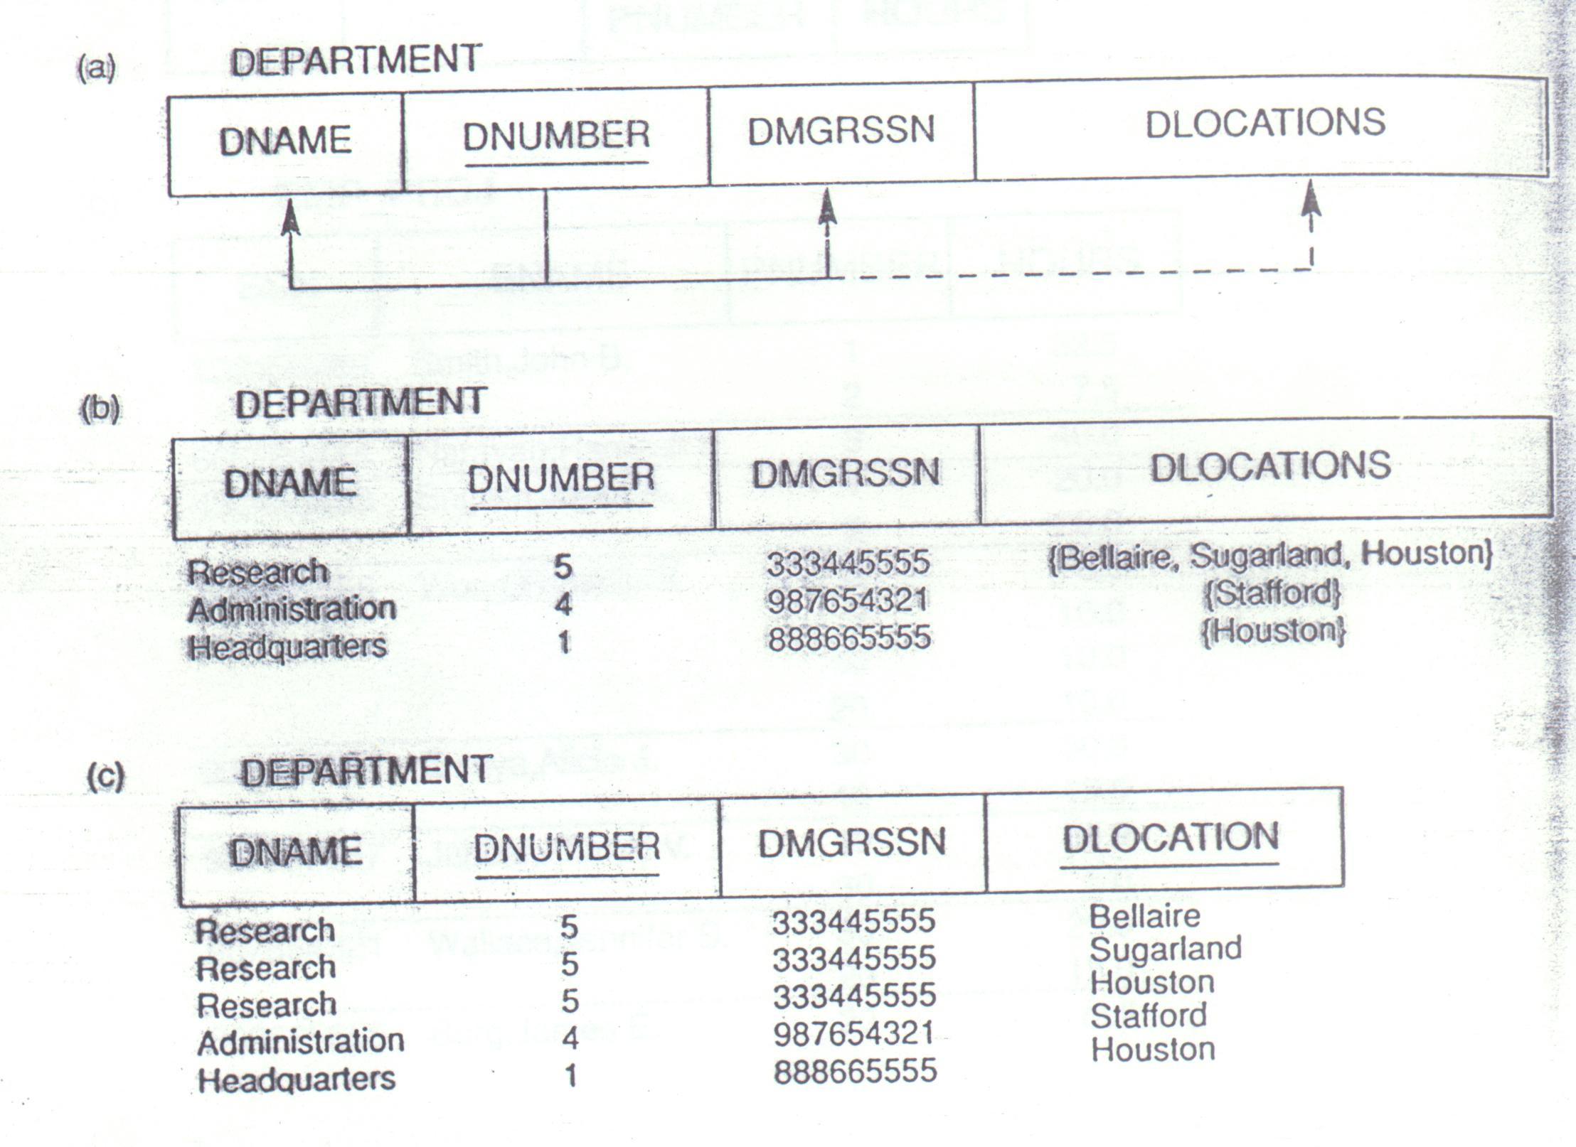
Figure 14.8

Slide 26

Figure 14.9

Slide 27
3.3 Second Normal Form
Uses the concepts of FDs, primary key
Definitions:
  Prime attribute – attribute that is a member of the primary key K
  Full functional dependency – a FD Y → Z where removal of any attribute from Y means the FD does not hold any more
  Examples:
  {SSN, PNUMBER} → HOURS is a full FD since neither SSN → HOURS nor PNUMBER → HOURS hold

Slide 28
(cont.)
  {SSN, PNUMBER} → ENAME is not a full FD (it is called a partial dependency) since SSN → ENAME also holds
A relation schema R is in second normal form (2NF) if every non-prime attribute A in R is fully functionally dependent on the primary key
R can be decomposed into 2NF relations via the process of 2NF normalization

Slide 29
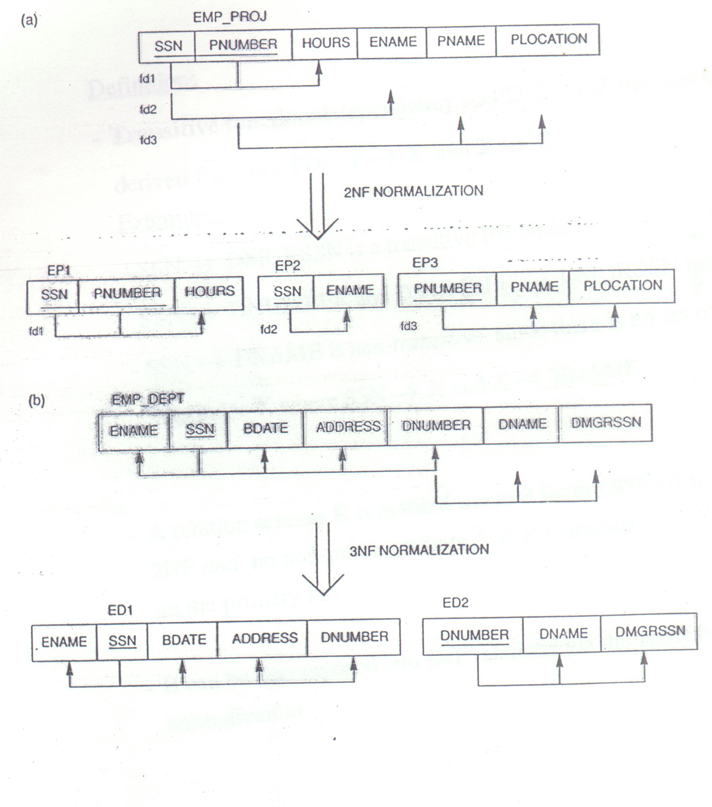
Figure 14.10

Slide 30
3.4 Third Normal Form
Definition:
  Transitive functional dependency – a FD Y → Z that can be derived from two FDs Y → X and X → Z
  Examples:
  SSN → DMGRSSN is a transitive FD since
  SSN → DNUMBER and DNUMBER → DMGRSSN hold
  SSN → ENAME is non-transitive since there is not an attribute X where SSN → X and X → ENAME
A relation schema R is in third normal form (3NF) if it is in 2NF and no non-prime attribute A in R is transitively dependent on the primary key
R can be decomposed into 3NF relations via the process of 3NF normalization

Slide 31
4 General Normal Form Definitions
(For Multiple Keys)
The above definitions consider the primary key only
The following more general definitions take into account relations with multiple candidate keys
A relation schema R is in second normal form(2NF) if every non-primary attribute A in R is fully functionally dependent on every key of R
Definition:
  Superkey of relation schema R – a set of attributes S of R that contains a key of R

Slide 32
(cont.)
  A relation schema R is in third normal form(3NF) if whenever a FD X → A holds in R, then either: (a) X is a superkey of R, or (b) A is a prime attribute of R
  Boyce-Codd normal form disallows condition (b) above
Why a relation satisfying condition (b) is still a 3NF?
Ans: 當key只有一個attribute(i.e., A)，可以看的很清楚R(A, X, Y, Z) : 如果 X→A, 那麼X也可以當Key, 所以這種時候，雖然relation裡有transitive dependency, 我們仍說R is in 3NF.

Slide 33
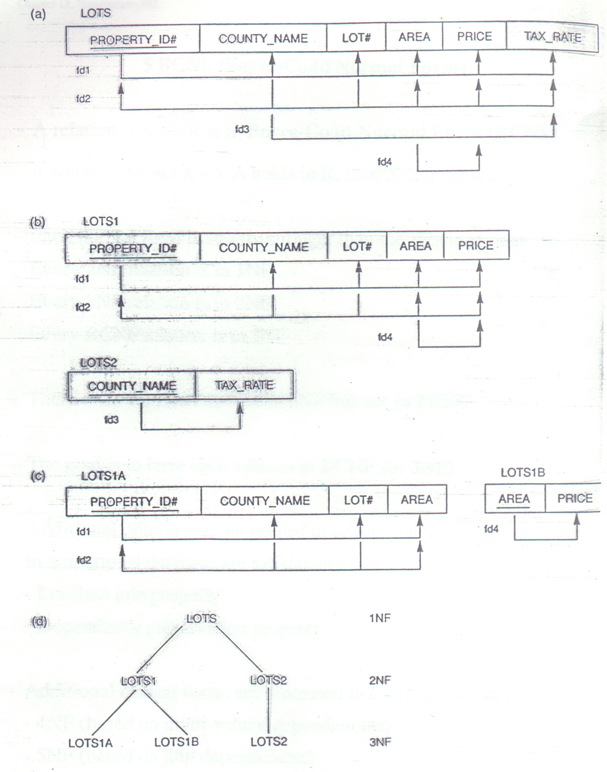
Figure 10.11

Slide 34
5 BCNF(Boyce-Codd Normal Form)
A relation schema R is in Boyce-Codd Normal Form(BCNF) if whenever a FD X → A holds in R, then X is a superkey of R
Each normal form is strictly stronger than the previous one:
  Every 2NF relation is in 1NF
  Every 3NF relation is in 2NF
  Every BCNF relation is in 3NF
There exist relations that are in 3NF but not in BCNF

Slide 35
(cont.)
The goal is to have each relation in BCNF(or 3NF)
Additional criteria may be needed to ensure the the set of relations in a relational database are satisfactory(see Chapter 15)
  Lossless join property
  Dependency preservation property
Additional normal forms are discussed in Chapter 14
  4NF(based on multi-valued dependencies)
  5NF(based on join dependencies)

Slide 36
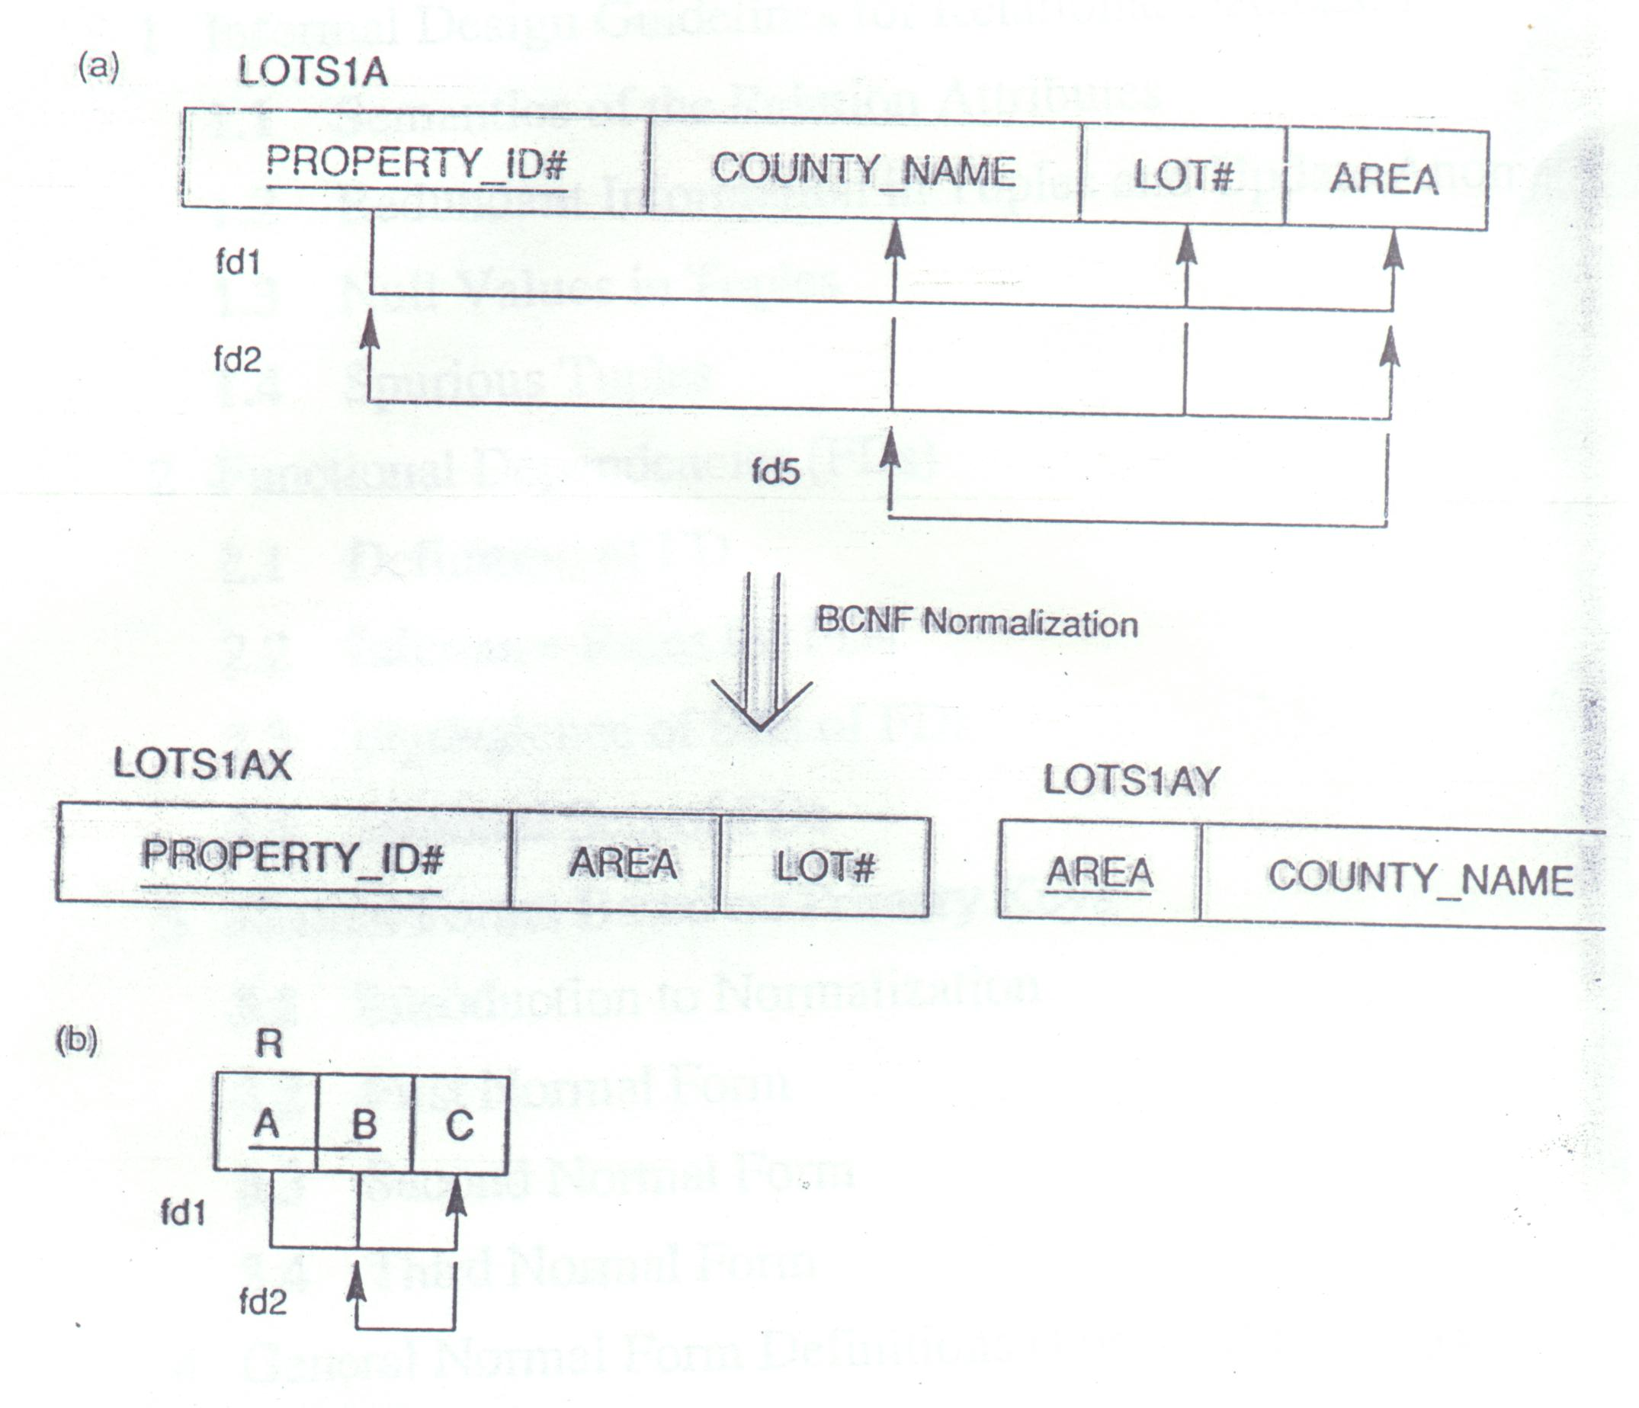
Figure 10.12

Slide 37
How to decompose relation?
If the relation (unsatisfying BCNF) has two candidate keys
  Figure 10.12(a)’s relation can be decomposed to two BCNF relation because it has two candidate keys, {property_ID#} and {county_name, lot#}. So LOTS1AX and LOTS1AY can be joined back to the original relation.
  If property_ID# is not a candidate key but only {county_name, lot#} can be the key, then there is no way to decompose this relation (LOTS1A) into two BCNF relations.
If the relation (unsatisfying BCNF) has only one candidate key
  How to decompose Figure 10.12(b)? See the next example.

Slide 38
Another Example
FD2
Figure10.13 TEACH(Student, Course, Instructor)
FD1
There can be three possible decompositions:
{Student, Instructor} and {Student, Course}
{Course, Instructor} and {Course, Student}
{Instructor, Course} and {Instructor, Student}
All three decompositions “lose” the functional dependency FD1. (So, strictly speaking, all of them are not a good decomposition.)
But if we have to choose one, the third one is a better choice. The reason is that it will not generate spurious tuples after a join. (This is because Instructor -> Course. So {Instructor, Student} can also -> Course. So by joining these two relations on Instructor, there won’t be spurious tuples produced.

